Slide 1
Database Connectivity
Node JS

Slide 2

Ade Nur Hidayat
About Me
Latest Work Experience :
Middleware Development Specialist , AXA Mandiri 2021 – Present
Java Developer , Difini Technology 2018 – 2021
Education :
Andalas University 2013 – 2018
Bachelor of Information System
Social Media :
https://www.linkedin.com/in/adenurhidayat/

Slide 3




Ground Rules
Give full attention
in class
Keep your camera on
Use raise hand or chat
to ask questions
Make this room a safe place
to learn and share

Slide 4
Learning Objective
Introduction Node.js dan Database
Exploring Database Connectivity Libraries
Establishing Database Connection
Performing Database Operations
Real-world Application Development
Notes:
Pada akhir tujuan pembelajaran ini, peserta harus memiliki pemahaman komprehensif tentang konektivitas database di Node.js, sehingga memungkinkan mereka membangun aplikasi yang kuat dan efisien yang berinteraksi secara lancar dengan berbagai sistem database.

Slide 5
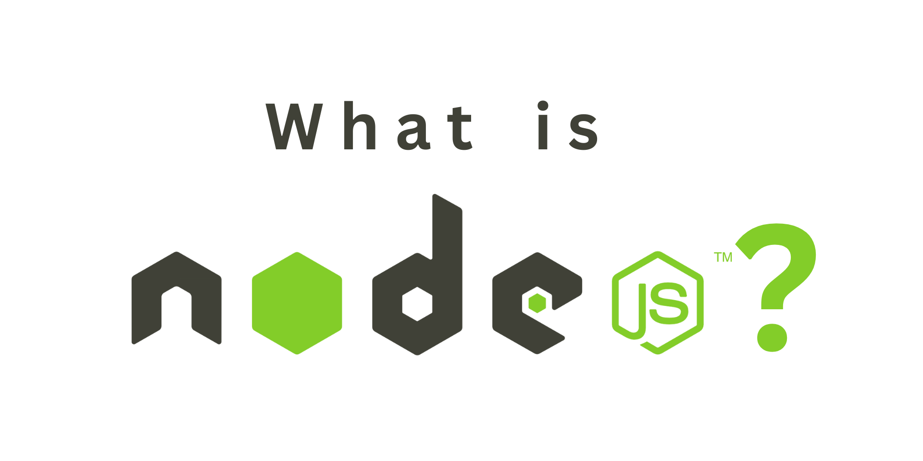
Notes:
Platform open-source untuk menjalankan kode JavaScript di sisi server. Node.js memungkinkan pengembang untuk menggunakan JavaScript untuk mengembangkan aplikasi server-side yang efisien dan skalabel.

Slide 6
Javascript as a Backend
Express
React
Nest.js
Koa.js
Hapi.js
Sails.js
etc

Slide 7
Database Connectivity Library
MySql -> mysql, mysql2
PostgreSql -> pg
SQL Server -> mssql
Mongodb -> mongoose
Etc.

Slide 8
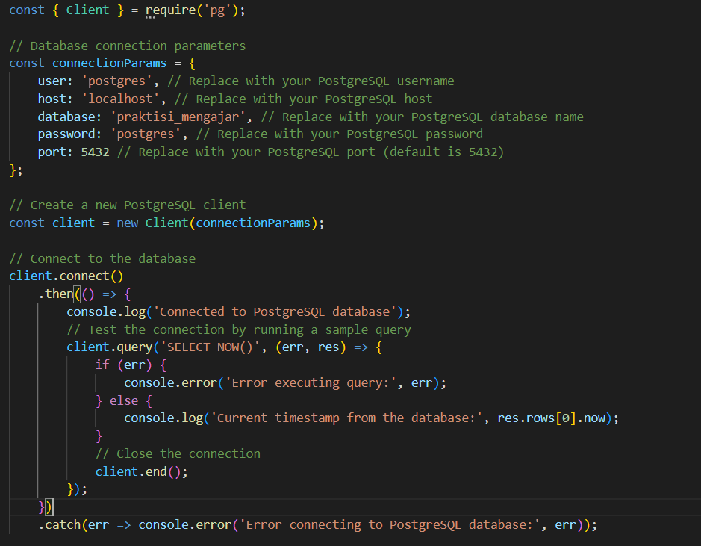

Establishing Database Connection
Example of connecting to a PostgreSQL
database without ORM
Notes:
In the traditional approach, developers interact directly with the database using SQL queries

Slide 9
Establishing Database Connection using ORM
ORM offer several benefits:
Increased Productivity
Portability
Reduced Development Time
Improved Maintainability
Notes:
ORM stands for Object-Relational Mapping. It is a programming technique used to convert data between incompatible type systems, such as object-oriented programming languages and relational databases. ORM frameworks enable developers to work with databases using object-oriented paradigms, abstracting the complexities of SQL queries and database interactions.

Slide 10
Database Connection using ORM
Sequelize
Prisma
TypeORM
LoopBack
RxDB
Mangoose
Waterline
CaminteJs
BookShelf
Objection.js
Node-ORM2
MikroORM

Slide 11
Command
Using Sequelize
npm install sequelize mysql2 -> support async/await
Using Prisma
npm install -g prisma
prisma init
prisma generate

Slide 12
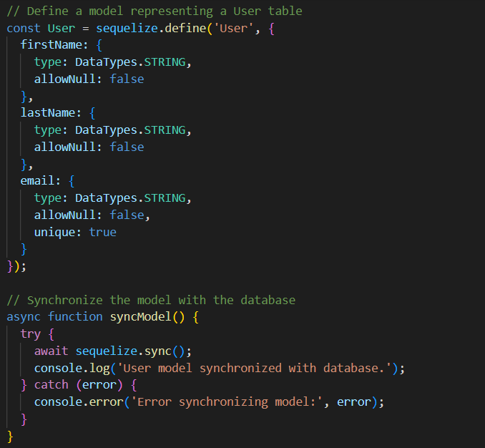

Establishing Database Connection with ORM
Notes:
https://gist.github.com/ADENH/b01152152d3006e4dd4f9df404f69b8a

Slide 13
Implementation

Slide 14
Quiz
Notes:
https://quizizz.com/join?gc=922013

Slide 15
https://github.com/ADENH/pweb-node-js
Notes:
https://github.com/ADENH/pweb-node-js

Slide 16
Discussion

Slide 17
Terima Kasih

